Slide 1
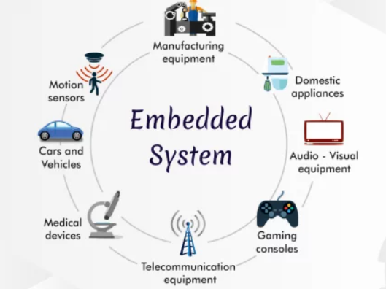
Electronics and Embedded Systems Course
Comprehensive Curriculum

Slide 2

Overview
Introductory Session: Electronics and Embedded Systems
Circuit Analysis, Instrument Measurement, and Tools
Ohms law, voltage divider, opto-coupler, led-driver, BJT-MOSFET switch design, ESD, Voltage regulators and power supply.
Schematic capture and simulations, easyeda login
Communications & Protocols
UART-RS-323, RS-485, I2C, SPI, ONE WIRE, SIM, LTE, BLE, Zigbee, LoRa etc.
Introduction to ESP32: Hardware-Related Programming Environment
Arduino - IDE

Slide 3
Overview
Input-Output Devices, Sensors, and Actuators
All sensors available in market, gps, magnetometer, loadcells, thermocouples
DC, BLDC motors, solenoids, relays
IoT with Arduino + ESP32 Core few weeks
Hardware design and development
Industrial automation
Embedded systems using C/C++
Android for user interface
Web development for dashboard
PCB Design, Machinery, and Processing
Prototype and 3D Printing

Slide 4
Weekly Structure
Point 1: Assignment (15-min)
Point 2: Main Course Content (Middle Hours)
Point 3: Q/A, Task Assignment and Discussion (Last 15-min)
Online Assignments

Slide 5

Course Duration
4 Hours Per Week
2-hrs twice a week, Friday-Wednesday 8-10am
Total of 12 Weeks 48-hrs

Slide 6
Day-1 (zoom meeting)
Introductory Session:
Course Objectives: Aamir (15-min)
Q/A and student's introduction: (15-min)
IoT Big Picture: Sohail (30-min)
Electronics and Embedded Systems: Azmat (45-min)
Short demos: Mubashir (15-min)

Slide 7
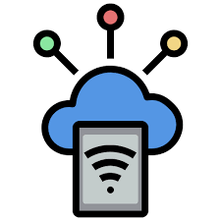
IoT SPRING’24
INTRODUCTION TO
INTERNET OF THINGS

Slide 8
Contents
History of Innovation Cycles
What is IoT & Why it is needed
IoT cycle & How does IoT works
IoT Components, Categories, Uses & Risks
IoT Network & Connectivity Options
IoT Applications and Smart Solutions

Slide 9
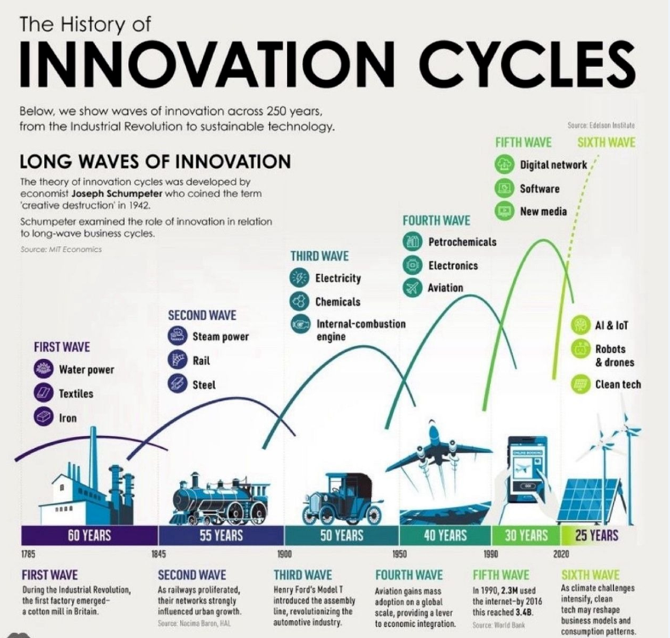

Slide 10
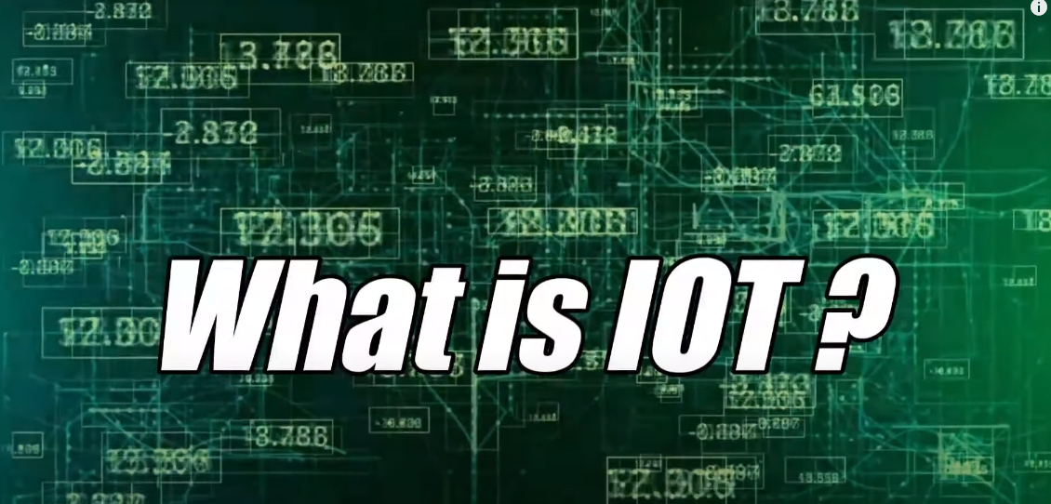
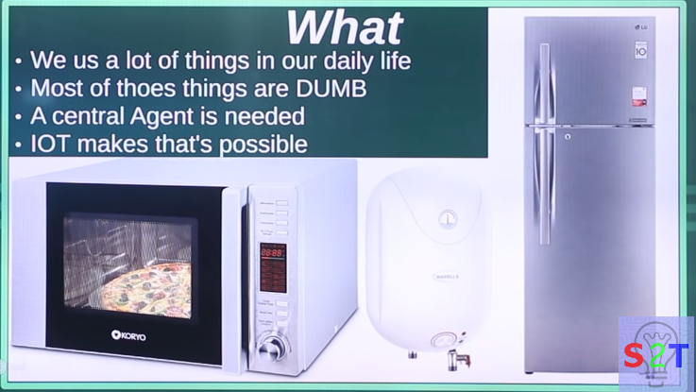

IoT SPRING’24
We use a lot of things in our daily life
Most of those things are DUMB
A central agent is needed
IoT makes that’s possible

Slide 11
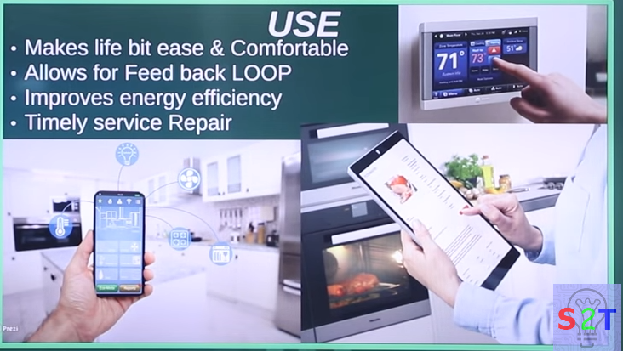
USE
IoT SPRING’24
Remote monitoring of devices
Makes life a bit easier & more comfortable
Allows for feedback loop.
Improves energy efficiency.
Timely service repair.

Slide 12
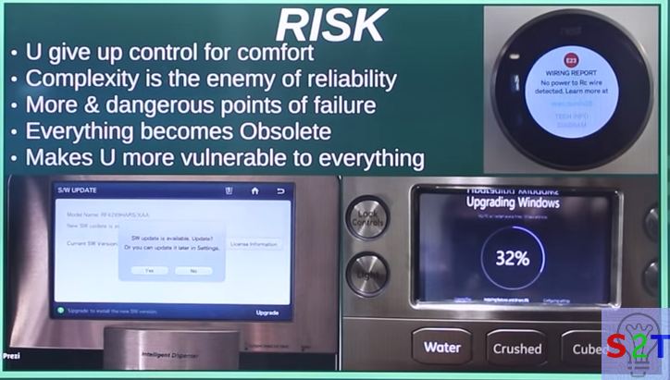
RISK
IoT SPRING’24
You are giving up control for comfort
Complexity being the enemy of reliability
More and dangerous points of failure
Everything becoming obsolete
Makes you more vulnerable to everything

Slide 13
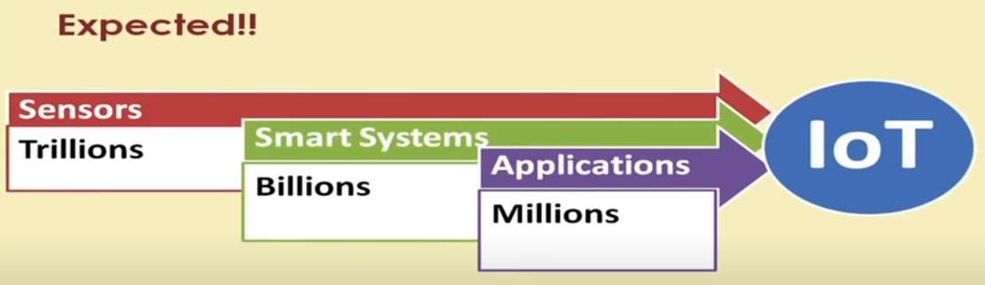
Who invented IoT
In 1999 Kevin Ashton invented the concept of the internet of things
The number of IoT devices available has grown from zero to around 27 billion.
Today, connectivity options include proprietary and cellular wireless transceivers that broadcast data to IoT devices a few feet or a few miles away and satellites that transmit data from orbit.

Slide 14
IoT Cycle
Devices
Connectivity
Any device
Any body
Any where
Any Business
Any Network
Any time
User Interface
Data Process

Slide 15
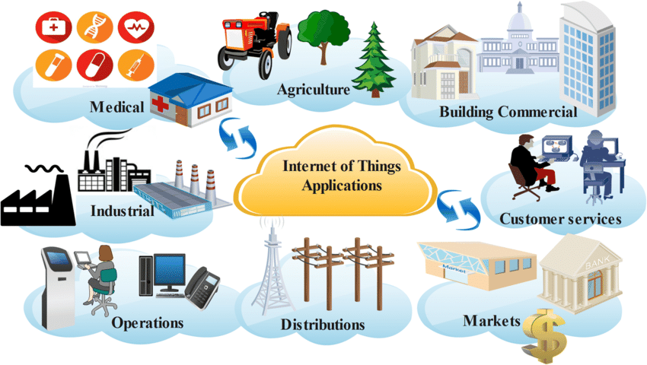
INTERNET OF THINGS INNOVATIVE EXAMPLES

Slide 16
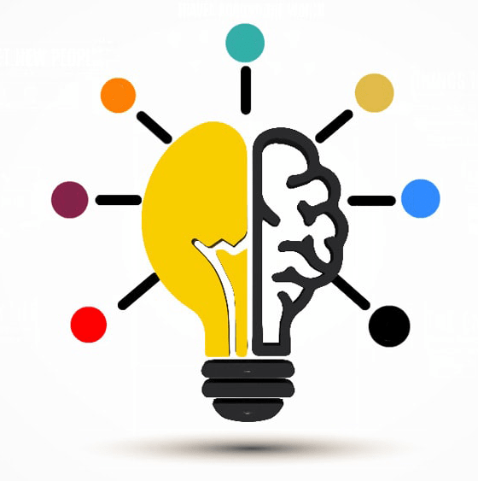
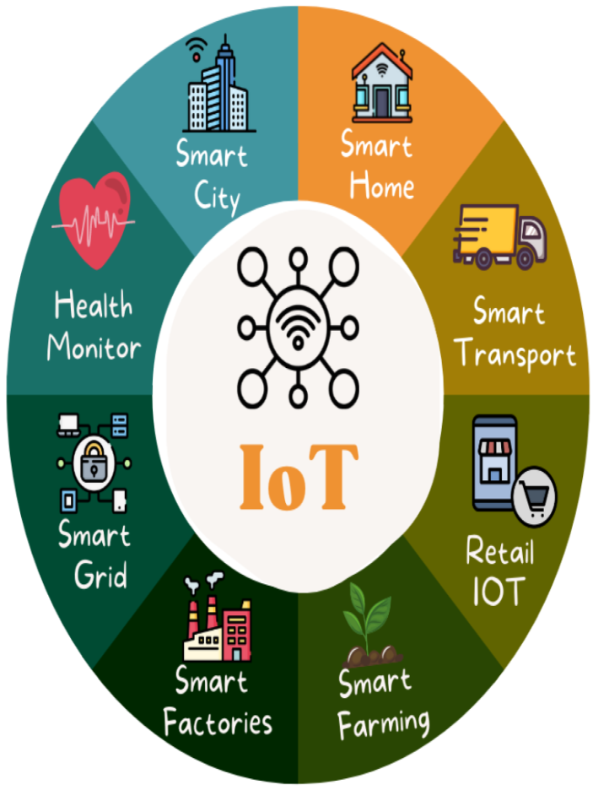
Applications of IoT
Smart Home Automation:
IoT devices such as smart thermostats, lighting systems, security cameras, and connected appliances enable homeowners to automate and control various aspects of their homes remotely.
Healthcare Monitoring:
Wearable devices equipped with sensors can monitor vital signs, track physical activity, and send real-time health data to healthcare professionals, providing timely insights and improving patient care.
Industrial Internet (Industry 4.0):
IoT is extensively used in industries for predictive maintenance, asset tracking, and process optimization. Connected sensors on machines and equipment enable proactive maintenance, reducing downtime and improving efficiency.

Slide 17
Applications of IoT
Smart Cities:
IoT contributes to the development of smart cities by integrating sensors and data analytics into urban infrastructure. This includes smart traffic management, waste management, energy-efficient street lighting, and environmental monitoring.
Agricultural Monitoring:
IoT devices, such as soil sensors and drones, help farmers monitor crop conditions, manage irrigation more efficiently, and optimize farming practices for increased yield and sustainability.
Retail and Inventory Management:
Retailers use IoT for inventory tracking, supply chain optimization, and enhancing the overall shopping experience through technologies like smart shelves and connected beacons.

Slide 18
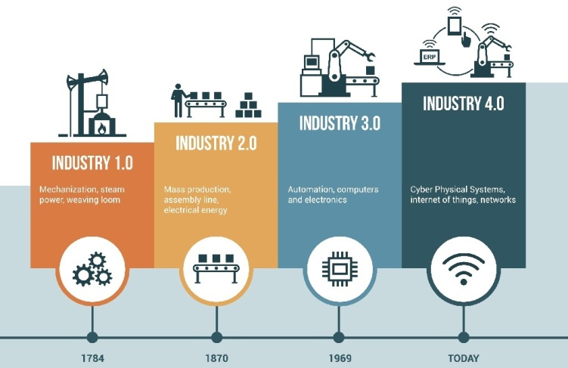
Applications of IoT
Environmental Monitoring:
IoT sensors are deployed for monitoring and collecting data on environmental conditions, including air and water quality, to support sustainable practices and early detection of environmental issues.
Connected Vehicles:
IoT is integrated into vehicles for real-time monitoring, predictive maintenance, and enhancing safety. Connected cars can communicate with each other and with traffic infrastructure to improve traffic flow and reduce accidents.
Energy Management:
Smart meters, sensors, and connected devices help optimize energy consumption in homes, businesses, and industries, contributing to energy efficiency and cost savings.

Slide 19
Applications of IoT
Supply Chain Visibility:
IoT is used to track and monitor goods throughout the supply chain. This provides real-time visibility, improves logistics, and helps prevent issues such as theft or spoilage.
Asset Tracking:
Companies use IoT to track the location and condition of valuable assets, equipment, and inventory, leading to better asset management and increased operational efficiency.

Slide 20
IoT Components
Device The Thing
Local Network
Internet
Backend Services
Applications

Slide 21
How does IoT work?
Internet of Things platform
An IoT platform manages device connectivity. It can be a software suite or a cloud service. The purpose of an IoT platform is to manage and monitor hardware, software, processing abilities, and application layers.
Sensor technologies
IoT sensors, sometimes called smart sensors, convert real-world variables into data that devices can interpret and share. Many different types of sensors exist. For example, temperature sensors detect heat and convert temperature changes into data. Motion sensors detect movement by monitoring ultrasonic waves and triggering a desired action when those waves are interrupted.
Unique identifiers
The core concept of the IoT is communication among devices and users. Unique identifiers (UIDs) establish the context of a device within the larger network to enable this communication. Identifiers are patterns, like numeric or alphanumeric strings. One example of a UID that you might be familiar with is an internet protocol (IP) address. They can identify a single device (instance identifier) or the class to which that device belongs (type identifier).

Slide 22
How does IoT work?
Internet connectivity
Sensors can connect to cloud platforms and other devices through a host of network protocols for the internet. This enables communication between devices.
Artificial intelligence (AI) and machine learning
Natural language processing (NLP) in IoT devices makes it easier for users to input information and interact with devices. One common example of an IoT device that utilizes NLP technology is the Amazon Alexa. Machine learning also enhances the analytical capabilities of IoT devices.
Edge computing
Edge computing is a computing framework. It aims to conserve resources and speed up response time by moving computational resources like data storage closer to the data source. The IoT accomplishes this by utilizing edge devices like IoT gateways.

Slide 23
Features of IOT
The most important features of IoT on which it works are connectivity, analyzing, integrating, active engagement, and many more. Some of them are listed below:
Connectivity :
Connectivity refers to establish a proper connection between all the things of IoT to IoT platform it may be server or cloud. After connecting the IoT devices, it needs a high speed messaging between the devices and cloud to enable reliable, secure and bi-directional communication.
Analyzing :
After connecting all the relevant things, it comes to real-time analyzing the data collected and use them to build effective business intelligence. If we have a good insight into data gathered from all these things, then we call our system has a smart system.
Integrating :
IoT integrating the various models to improve the user experience as well.
Artificial Intelligence :
IoT makes things smart and enhances life through the use of data. For example, if we have a coffee machine whose beans have going to end, then the coffee machine itself order the coffee beans of your choice from the retailer.

Slide 24
Features of IOT
Sensing :
The sensor devices used in IoT technologies detect and measure any change in the environment and report on their status. IoT technology brings passive networks to active networks. Without sensors, there could not hold an effective or true IoT environment.
Active Engagement :
IoT makes the connected technology, product, or services to active engagement between each other.
Endpoint Management :
It is important to be the endpoint management of all the IoT system otherwise, it makes the complete failure of the system. For example, if a coffee machine itself order the coffee beans when it goes to end but what happens when it orders the beans from a retailer and we are not present at home for a few days, it leads to the failure of the IoT system. So, there must be a need for endpoint management.

Slide 25
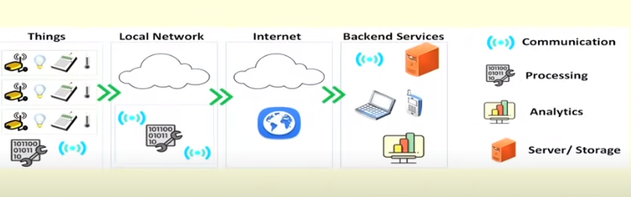
Scenarios of IoT

Slide 26
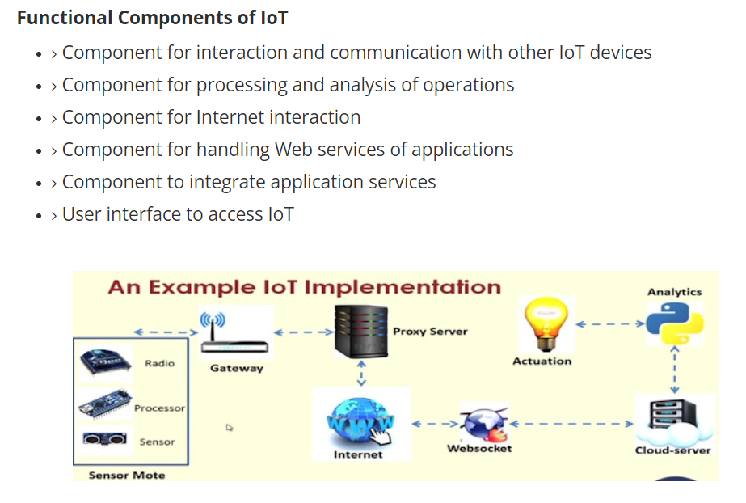

Slide 27
IoT Categories
Industrial IoT
IoT device connects to an IP network and the global network.
Communication between the nodes done using regular as well as industry specific technologies.
Consumer IoT
IoT device communicates with in the locally networked devices.
Local communication is done mainly via Bluetooth, Zigbee or Wifi.
Generally limited to local communication by a Gateway.

Slide 28
IoT Challenges
Security
Interfacing
Scalability
Interoperability
Energy efficiency
Data storage
Bandwidth management
Data Analytics
Modeling and Analysis
Complexity management (e.g., SDN)

Slide 29
Considerations
Communication between the IoT devices and the outside world dictates the network architecture.
Choice of communication technology dictates the IoT device hardware requirements and costs.
Due to the presence of numerous applications of IoT enabled devices, a single networking paradigm not sufficient to address all the needs of the consumer or the IoT device.

Slide 30
Complexity of Networks
Growth of Networks
Interference among devices
Network management
Heterogeneity in the networks
Protocols standardization within networks

Slide 31
Wireless Networks
Traffic and load management
Variations in wireless networks – Wireless Body Area Networks and other Personal Area Networks
Interoperability
Network management
Overlay networks
Scalability
Flexibility within internet
IoT integration
Large scale deployment
Real-time connectivity of billions of devices

Slide 32

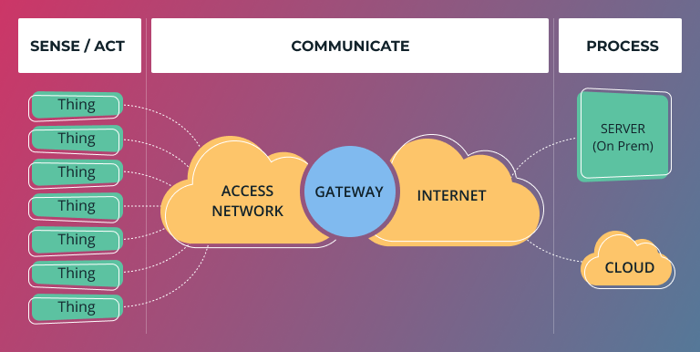
RISKS
The Internet of Things (IoT) introduces specific risks and challenges due to the interconnected nature of devices and the massive amounts of data they generate. Some of the key risks associated with IoT include:
Security Risks:
IoT devices may become targets for cyberattacks, leading to unauthorized access, data breaches, or manipulation of device functionalities. Insecure communication channels, weak authentication, and inadequate encryption can contribute to security vulnerabilities.
Privacy Concerns:
The extensive data collection capabilities of IoT devices raise privacy concerns. Personal and sensitive information may be collected without proper consent, leading to potential misuse or unauthorized access to individuals' data.

Slide 33

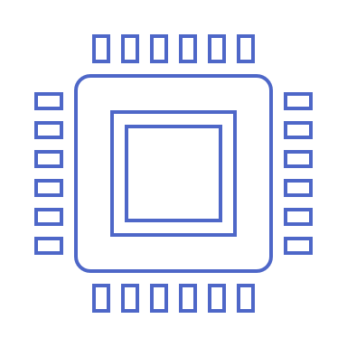
IOT ESSENTIALS
AN Introduction
ELECTRONICS AND EMBEDDED SYSTEMS
Azmat

Slide 34
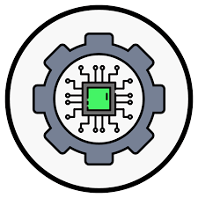
Internet Of Things
OVERVIEW OF ELECTRONICS
Unlocking the world of Electronics

Slide 35

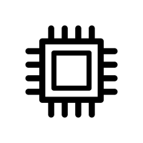

Agenda
Overview of Electronics
Definitions, Role of Electronics, Applications, and Basic Components
Introduction to Embedded Systems
Definitions, Role of Embedded Systems and Applications, Components of Embedded Systems and the mix of Electronics and Embedded Systems
Recap and Q&A
Recap with some basic quiz questions and Q&A

Slide 36

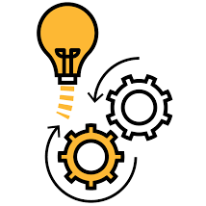

ROLE OF ELECTRONICS
Information Processing
Embedded systems automate specific functions within devices, streamlining processes and enhancing efficiency. For example, they control the timing and execution of tasks in a car's engine management system.
Enabling Modern Life
They enable instantaneous responses to external stimuli, crucial for applications like anti-lock braking systems in vehicles, ensuring precise and timely interventions for enhanced safety.
Connected World
Electronics play a pivotal role in pioneering smart solutions, connecting devices, and shaping a seamlessly integrated and interconnected world.

Slide 37


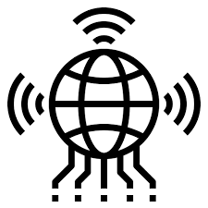

Electronics Used Everywhere!
Medical
4
Precision healthcare, remote monitoring
Electric Vehicles
Sustainable mobility
revolution
3
Smartphones
Information processing at your fingertips
2
IoT
Enabling a modern life-style
1

Slide 38
BASIC COMPONENTS
Voltage and current sources
Diodes, Transistors and ICs
Resistors, Capacitors and Inductors
Controlling the flow of Electrons
Switches
Active Components
Sources
Passive Components
Reference point for Voltage Level
Ground

Slide 39
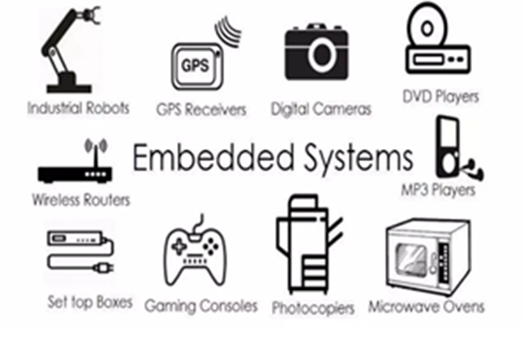
What is Embedded System
An embedded system is an electronic/electro-mechanical system designed to perform a specific function and a combination of hardware and firmware (software).
Every embedded system is unique and the hardware as well as the firmware is highly specialized to the application domain.
Embedded system are becoming an inevitable part of any product or equipment, industrial control, consumer products, etc.

Slide 40
EMBEDDED SYSTEMS
INTRO TO
EMBEDDED SYSTEMS
Exploring the heart of Technology

Slide 41
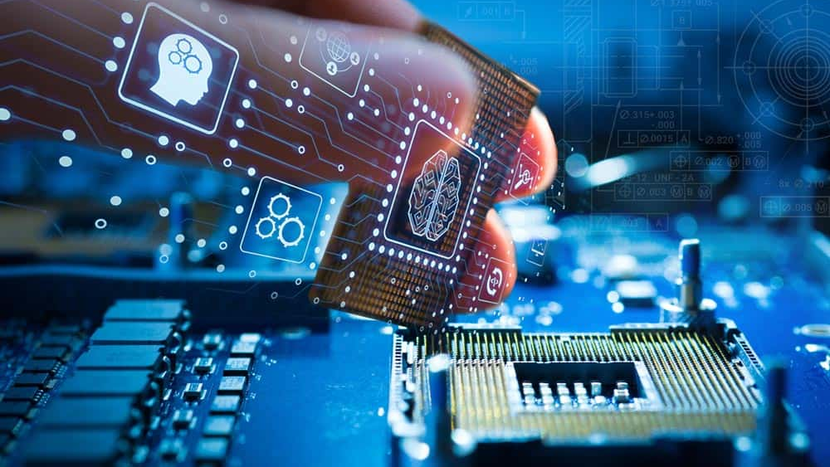

WHAT IS AN
EMBEDDED SYSTEM?
An embedded system is a combination of computer hardware and software designed for a specific function

Slide 42
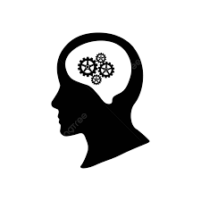

ROLE OF AN EMBEDDED SYSTEMS
The Silent Intelligence
The intricate network of embedded systems silently orchestrating modern technology, enhancing efficiency, and automating everyday tasks.
The Nervous System of IoT
Serving as the neural network, embedded systems play a pivotal role in connecting, sensing, and controlling devices within the vast ecosystem of the Internet of Things.
Bridging the Physical and Digital Realms
Acting as the bridge between the physical and digital worlds, embedded systems seamlessly merge hardware and software to power diverse applications in our connected environment.

Slide 43

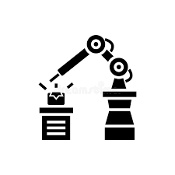
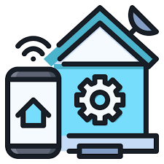
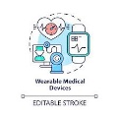
USE OF EMBEDDED SYSTEMS
Industrial Automation
4
Efficient process control
Precision Agriculture
Effective resource management
3
Wearable Health Devices
Life-saving monitoring
2
Smart Home Automation
Seamless control and monitoring
1

Slide 44
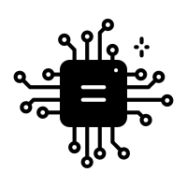

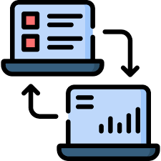

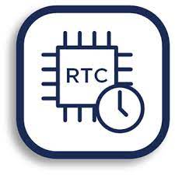
BUILDING BLOCKS
Microcontroller
Central Processor
Memory
Data Storage
Communication
Data Exchange
Sensors/Actuators
Real-time clock
Input perception/output execution
Timing precision

Slide 45
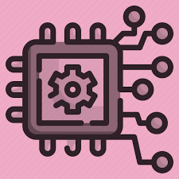
EMBEDDED SYSTEM
SYNERGY OF ELECTRONICS AND EMBEDDED SYSTEMS
Integration of Electronics
Embedded Intelligence
Electronics empower embedded systems with the intelligence to interact with the surrounding environment. Through the integration of sensors and processing units, electronics enable embedded systems to sense, process, and respond to real-world data, facilitating automation and smart functionalities.
Embedded systems heavily rely on electronic components, including microcontrollers, sensors, and actuators, to perform dedicated functions. Electronics serve as the foundational building blocks for embedded systems, providing the necessary hardware for computation and control.

Slide 46
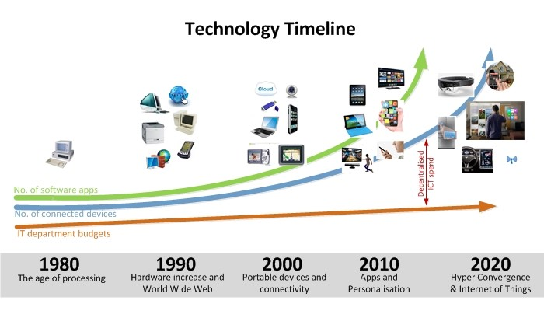
TECHNOLOGY TIMELINE

Slide 47
THANK YOU
QUESTIONS?

